Slide 1


Moore’s Law
The Prediction That Changed Technology Forever
Emma Green

Slide 2


Gordon E. Moore

Slide 3
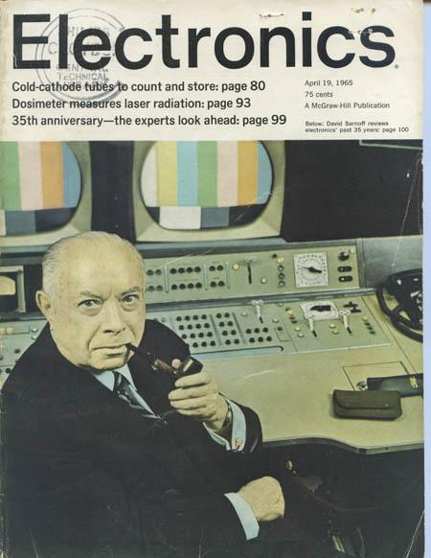
The Article
“Computers will be more powerful, and will be organized in completely different ways.”
-Gordon Moore, 1965

Slide 4
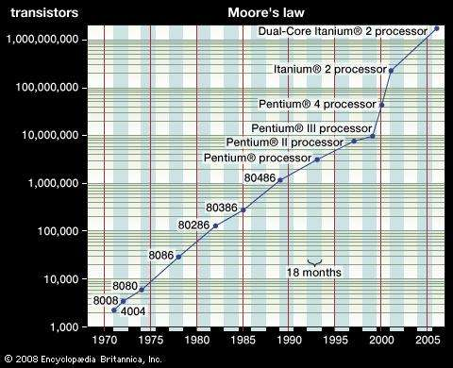
The Doubling Speed of Processors

Slide 5

The Doubters

Slide 6
Moore’s Impact

Slide 7
Sources
https://www.intel.com/content/www/us/en/silicon-innovations/moores-law-technology.html
https://www.computerhistory.org/siliconengine/moores-law-predicts-the-future-of-integrated-circuits/
https://www.cnet.com/news/moores-law-the-rule-that-really-matters-in-tech/
http://www.monolithic3d.com/uploads/6/0/5/5/6055488/gordon_moore_1965_article.pdf

